Slide 1
Final Talk Simulation of EEG Activity based on Sequential Sampling Models
M.Sc. Business Informatics Timo Zaoral

Slide 2
Table of Content
Introduction
Motivation & related work
Approach
Implementation & Integration
Results
Discussion

Slide 3



Introduction
What is this thesis about?
Human decision-making
Sequential Sampling Models (SSMs)
Simulating EEG activity
Why is this important?
Insights interpreting decision-related signals
Open debate in research
Simulated EEG data is useful for multiple tasks
Main Research Goal:
Extension development
Integration into UnfoldSim.jl
Investigate how SSMs can replicate decision-making
Notes:
What is this research about?
Investigating how the brain accumulates evidence to make decisions.
Using Sequential Sampling Models (SSMs) to describe decision-making processes.
Simulating EEG activity based on these models to understand their neural mapping.
Why is this important?
EEG provides insights into brain activity but has challenges in interpreting decision-related signals.
SSMs (e.g., Drift Diffusion Model (DDM), Linear Ballistic Accumulator (LBA), KellyModel) offer a framework to understand decision-making.
Directly linking these models to EEG data has been a challenge.
Main Research Goal:
Develop a computational toolbox for EEG simulation using SSMs.
Integrate the toolbox into UnfoldSim.jl, a Julia-based EEG simulation package.
Investigate how different SSMs influence EEG signals.

Slide 4
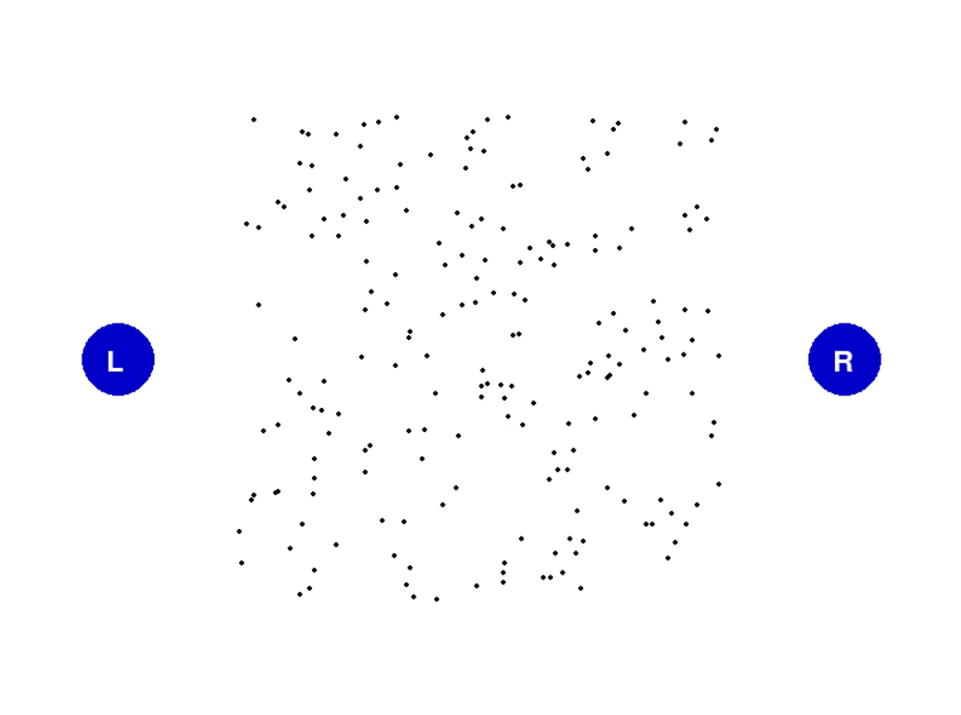
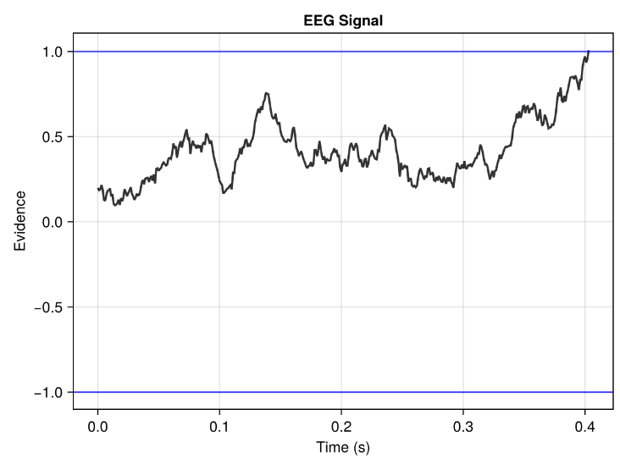
Motivation & related work
Changing coherence moving dots Experiment
Response Button L Threshold
Response Button R Threshold
own illustration
Notes:
In the task, dots move on a screen and a decision has to be made as to whether they move to the right or left. For this, a phase with incoherent/arbitrary movements was presented first, followed by coherent/steady movements. The number of coherent dots in the experiment was varied so that the researchers could investigate the neuronal processes of decision-making using the CPP at different levels of difficulty. Overall, this shows an experiment in which the evidence accumulation process in the brain is mirrored by the CPP. In der Aufgabe Bewegen sich Punkte auf einem Bildschirm und es ist zu entscheiden, ob sie sich nach Rechts oder Links bewegen. Dafür wurde zuerst eine Phase mit inkohärenten/willkürlichen Bewegungen präsentiert, gefolgt von kohärenten/gleichbleibenden Bewegungen. Die Anzahl an kohärenten Punkten im Experiment wurde variiert, sodass die Forschern, die neuronalen Prozesse der Entscheidungsfindung anhand vom CPP bei verschiedenen Schwierigkeitsgraden untersuchen konnten.

Slide 5
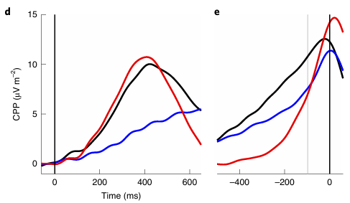
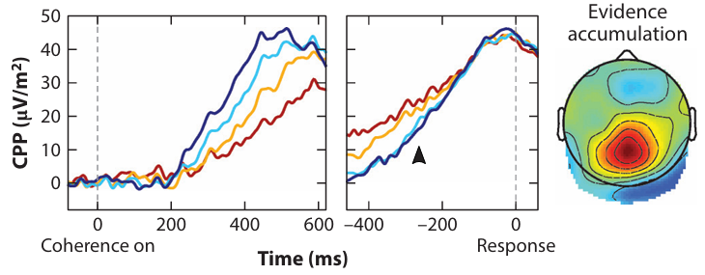
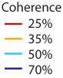
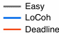
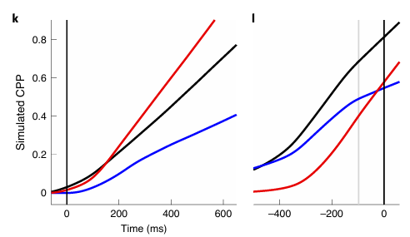
Motivation & related work
Evidence-dependent structural dynamics of the component centroparietal positivity (CPP) in the brain
Kelly et al. Neurophysiology of Human Perceptual Decision-Making 2021 [1]
Kelly et al. Neurocomputational mechanisms of prior-informed perceptual decision-making in humans 2021 [2]
Notes:
The number of coherent dots in the experiment was varied so that the researchers could investigate the neuronal processes of decision-making using the CPP at different levels of difficulty. Overall, this shows an experiment in which the evidence accumulation process in the brain is mirrored by the CPP.
On the right, we have a similar experiment but we can limit ourselves here to the course of a curve and look at this. Again the figures are divided in stimulus and response locked. In the top figure we see how the accumulation process of evidence on CPP level is similar to the left side figure. In the bottom figures the researchers used a SSM to simulate this behaviour. Therefore we can also see the accumulation process until the response is pressed and a decision has been made. But ofc it does not capture every behaviour of the real eeg data above.

Slide 6
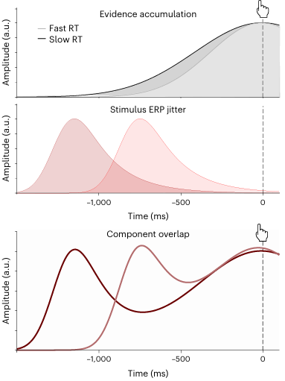
Motivation & related work
Frömer et al. Common neural choice signals can emerge artefactually amid multiple distinct value signals 2024 [3]
Notes:
Top: evidence accumulation signals expected for fast and slow RTs, respectively. Middle: when activity is locked to the response, this introduces jitter in stimulus locked activity, with stimulus-related activity appearing earlier and earlier as RTs increase (that is, the greater the delay between stimulus and response). Bottom: the convolution of the two patterns above can produce a pattern that is dominated by component overlap and obscures signatures of evidence accumulation.

Slide 7
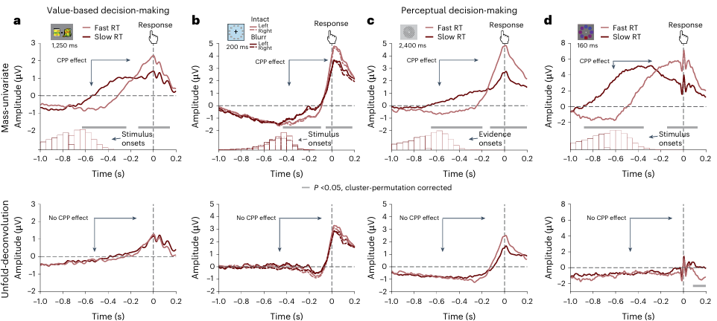
Motivation & related work
Frömer et al. Common neural choice signals can emerge artefactually amid multiple distinct value signals 2024 [3]

Slide 8
Motivation & related work
Understanding
Insights interpreting decision-related signals
Deconvolution
Techniques can separate overlapping components but need validation
EEG Overlap
Signals overlap, making it hard to distinguish actual decision-making activity
Challenges and Motivation
This study provides a flexible EEG simulation extension to test for example such models systematically

Slide 9
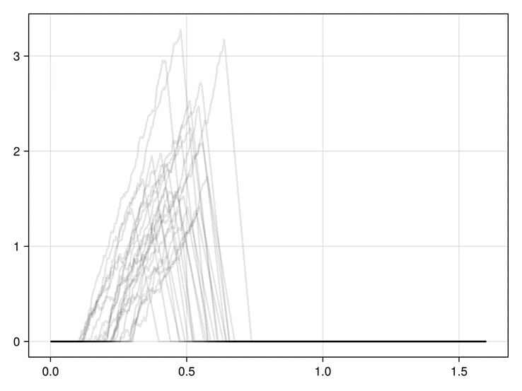
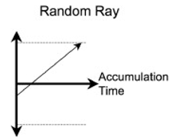
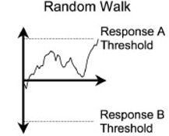
Approach
Theoretical Description of Sequential Sampling Models
linear ballistic accumulator (LBA)
drift-diffusion model (DDM)
Kelly et. al Model of neural activity
Brown et al. The simplest complete model of choice response time: Linear ballistic accumulation 2008 [4]
Own illustration based on Kelly et al. Code converted to Julia
Notes:
Firstly, I looked at the sequential sampling models and selected two models in addition to the Kelly model that I will use for the later implementation. Then I looked at the models theoretically and wrote a description for all these models, which will also be used in the later thesis.
On the left we have the comparison between the DDM and the LBA, the ddm has a constant drift rate combined with a diffusion factor that makes the movement random and adds a bit of noise. LBA is linearly accumulated and has only a constant drift rate in one direction. Therefore, the difference is also that LBA cannot reach two different thresholds as ddm can in a single trial.
On the right, we see some traces of the Kelly et al. model, which is inspired by a DDM but has more specific parameters that make it more adaptable. For example, stimulus processing and motor processes can vary.

Slide 10
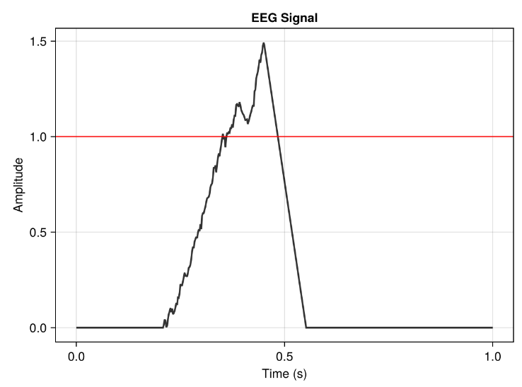
Approach
Kelly et. al Model of neural activity
Post accumulation spike
Boundary
Drift rate + Accumulation noise
Ramp down process
Sensory encoding delay
Motor encoding delay
Own illustration based on Kelly et al. Code converted to Julia
Notes:
Firstly, I looked at the sequential sampling models and selected two models in addition to the Kelly model that I will use for the later implementation. Then I looked at the models theoretically and wrote a description for all these models, which will also be used in the later thesis.
On the left we have the comparison between the DDM and the LBA, the ddm has a constant drift rate combined with a diffusion factor that makes the movement random and adds a bit of noise. LBA is linearly accumulated and has only a constant drift rate in one direction. Therefore, the difference is also that LBA cannot reach two different thresholds as ddm can in a single trial.
On the right, we see some traces of the Kelly et al. model, which is inspired by a DDM but has more specific parameters that make it more adaptable. For example, stimulus processing and motor processes can vary.

Slide 11
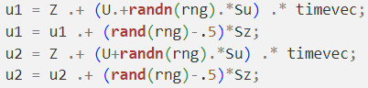
Approach
2. Reimplementation of the Kelly et. al Model
3. Integration into UnfoldSim
2.1 Understanding the code
3.1 Introduction to UnfoldSim.jl usage
2.2 Structured and methodical reimplementation
3.2 Adapting implementation to package paradigms
2.3 Parameters Docu.
3.3 Splitting functionalities and documenting code

Slide 12

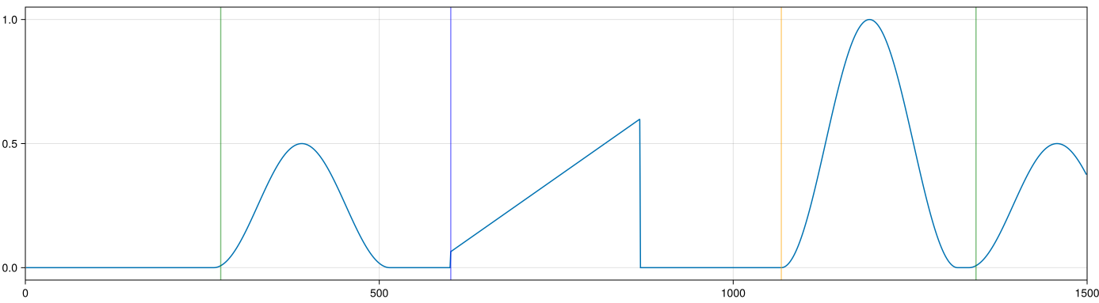
Implementation & Integration – Complete picture
SequenceDesign (S, C, R)
Stimulus(S)
Response(R)
Component(C)
Amplitude (a.u.)
Time (steps)
own illustration
Onsets (UniformOnset)
DriftComponent (LBA, DDM KellyModel)
Onsets (DriftOnset)
Notes:
In Animationen auftröseln das alles stück für stück kommt

Slide 13
Implementation & Integration
Design
Component
Model simulation
Onset
SingleSubjectDesign
SequenceDesign
RepeatDesign

Slide 14
Implementation & Integration
Design
Component
Model simulation
Onset
SingleSubjectDesign
DriftComponent
SequenceDesign
DriftComponent functions
RepeatDesign

Slide 15
Implementation & Integration
Design
Component
Model simulation
Onset
SingleSubjectDesign
DriftComponent
KellyModel
SequenceDesign
DriftComponent functions
SSM_Simulation functions
RepeatDesign

Slide 16
Implementation & Integration
Design
Component
Model simulation
Onset
SingleSubjectDesign
DriftComponent
KellyModel
SequenceOnset
SequenceDesign
DriftComponent functions
SSM_Simulation functions
DriftOnset
RepeatDesign
SequenceOnset/ DriftOnset functions

Slide 17
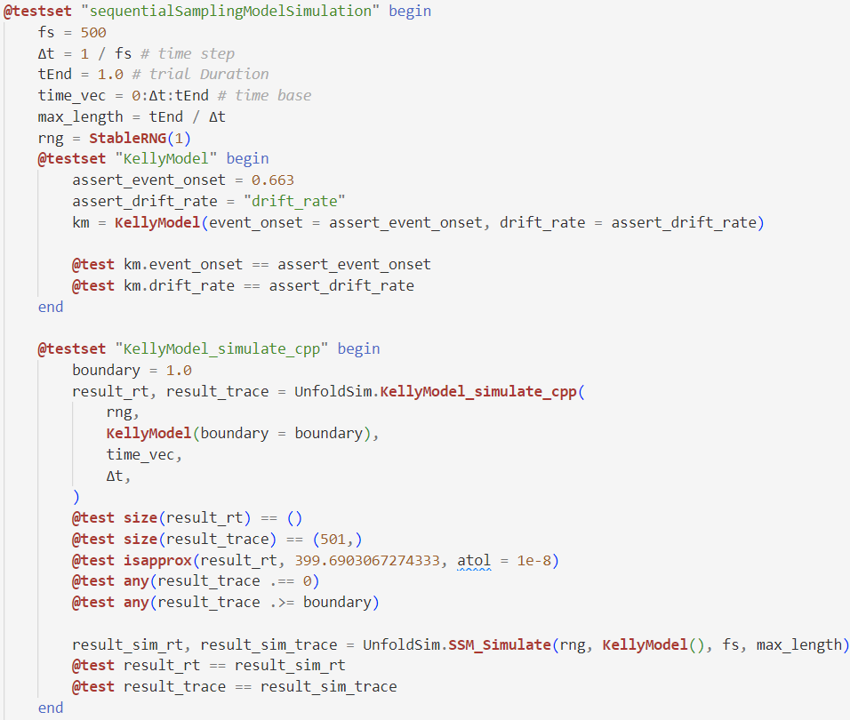
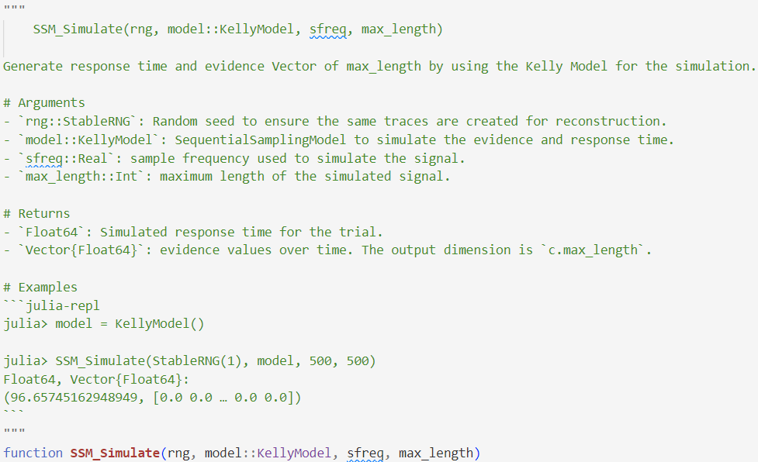
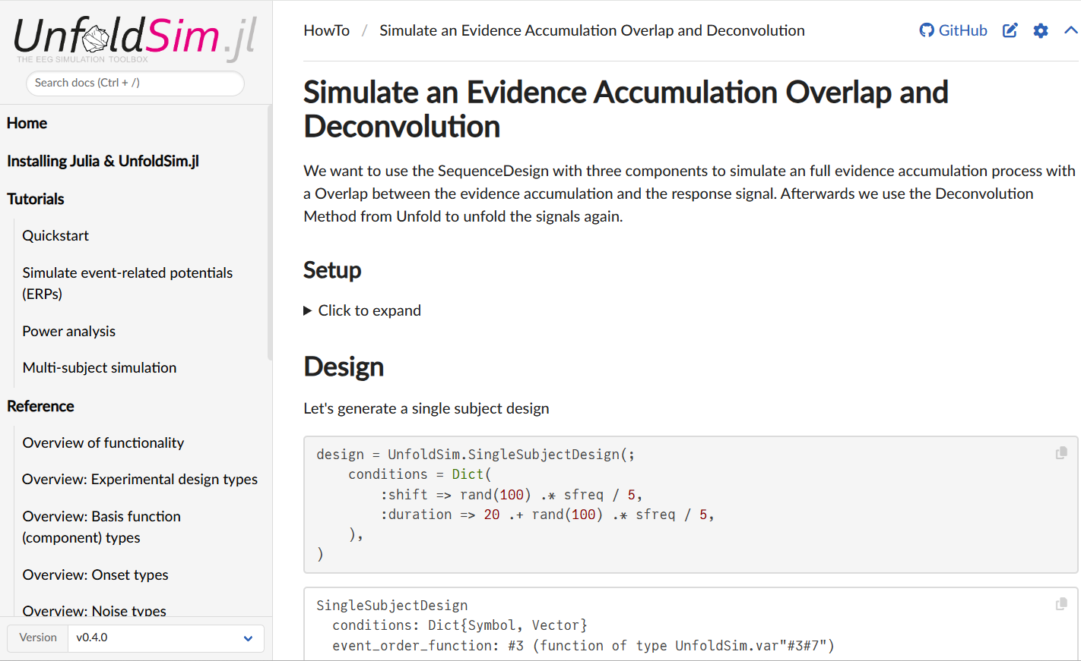
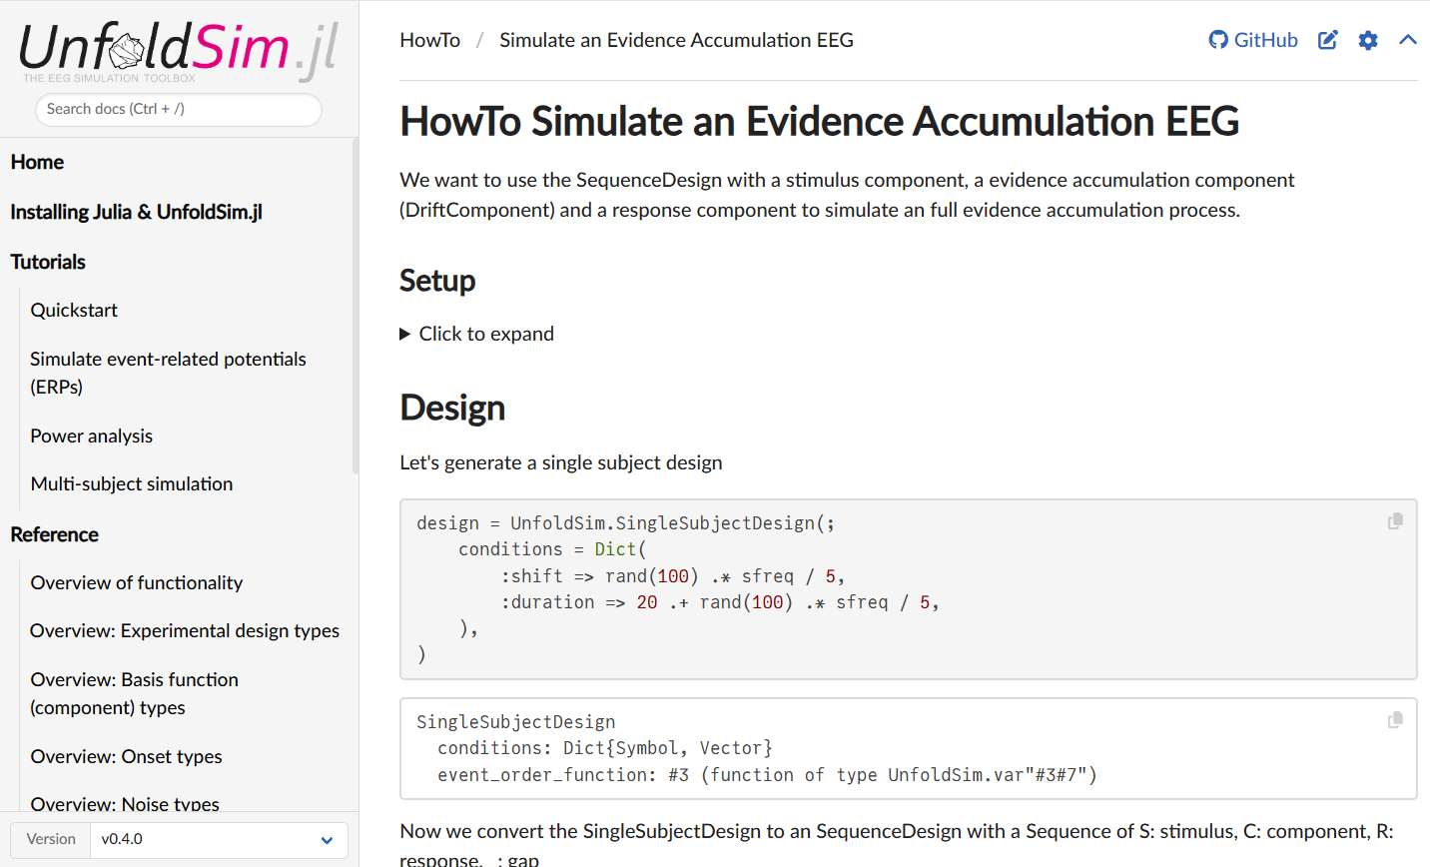
Implementation & Integration
Test Documentation
Notes:
Bilder von Testcode und den Documentationsseiten / DocStrings

Slide 18
Results
Simulation Space
Setup for all model simulations
LBA
DDM
KellyModel
Use Case
Setup for the use case
Results of a basic overlap deconvolution
Results of the simulated data

Slide 19
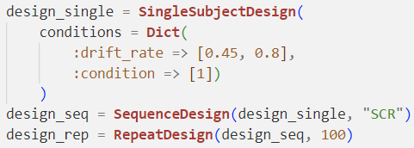


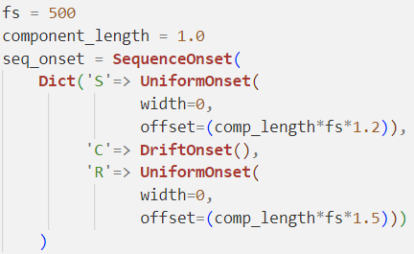
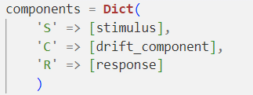


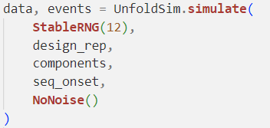
Results – Simulation Space - Setup
Design
Onsets
.
Components
Simulation

Slide 20
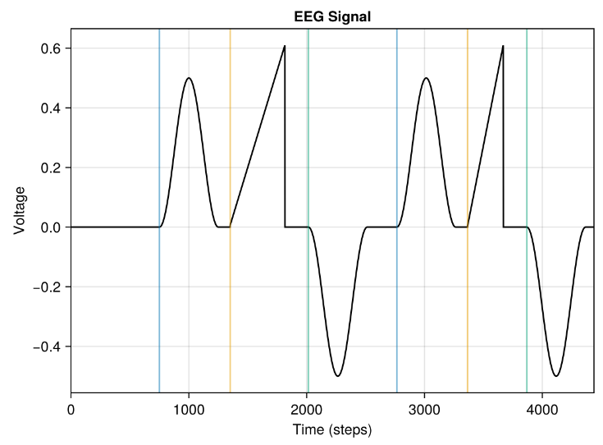
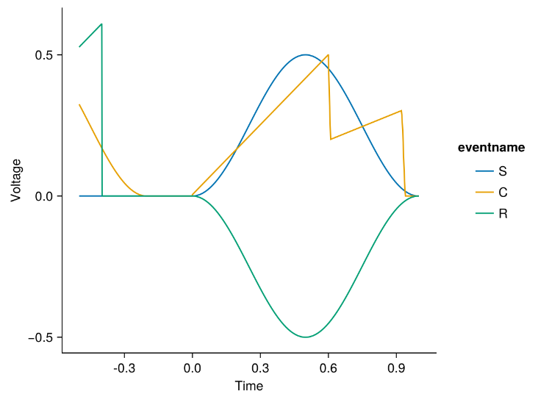
Results – Simulation Space - LBA
Legend Stimulus(S) Component(C) Response(R)
own illustration
own illustration

Slide 21
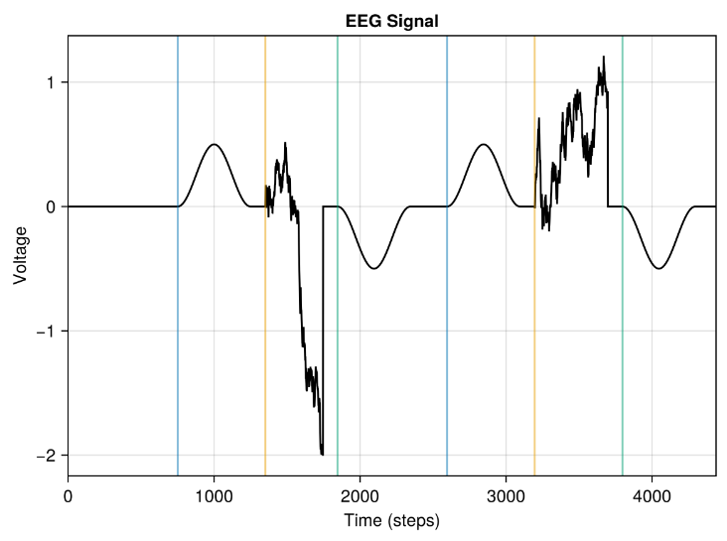
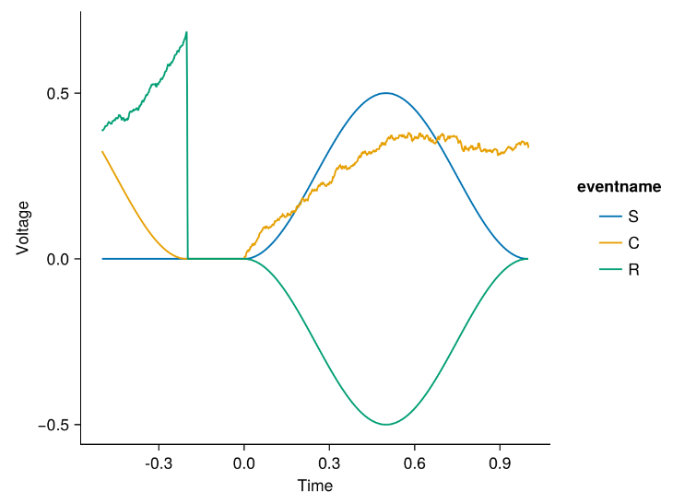
Results – Simulation Space - DDM
Legend Stimulus(S) Component(C) Response(R)
own illustration
own illustration

Slide 22
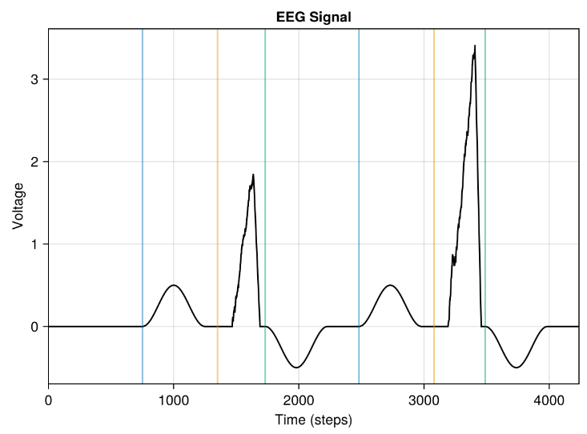
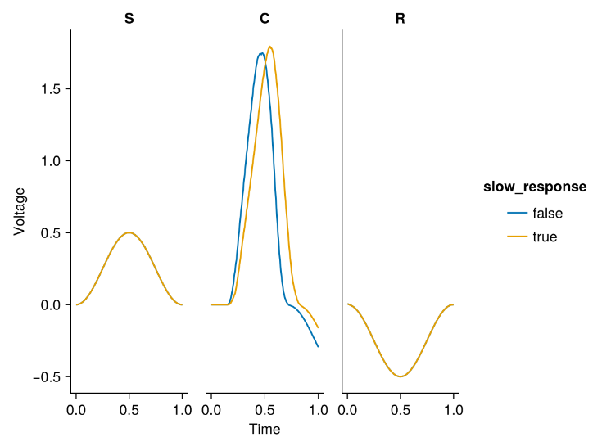
Results – Simulation Space - KellyModel
Legend Stimulus(S) Component(C) Response(R)
own illustration
own illustration

Slide 23
Results – No component activity after deconv
Frömer et al. Common neural choice signals can emerge artefactually amid multiple distinct value signals 2024 [3]

Slide 24
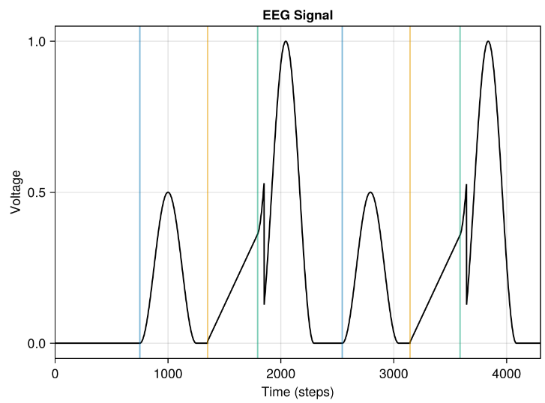
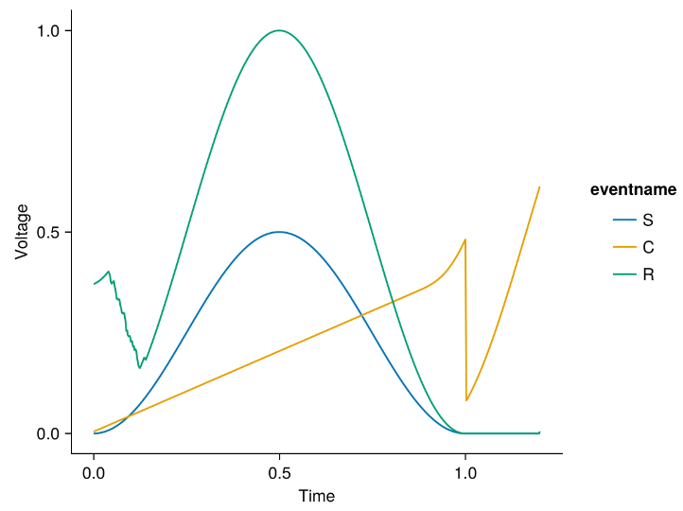

Results – Overlap Simulation - LBA
Legend Stimulus(S) Component(C) Response(R)
CPP
Time
own illustration
own illustration

Slide 25
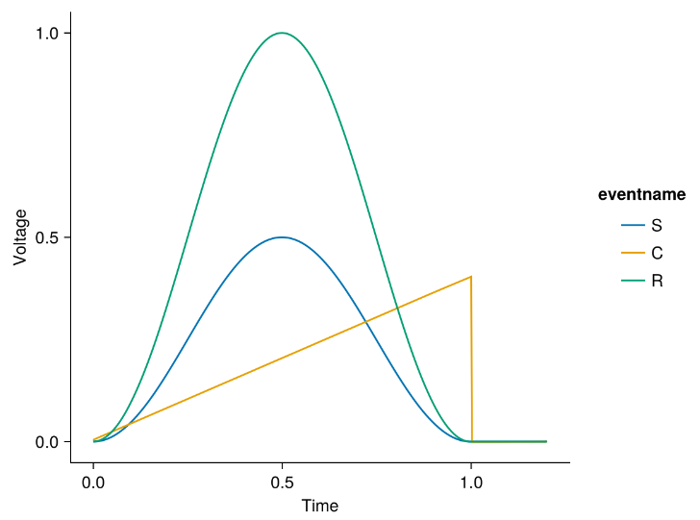
Results – Overlap Simulation - LBA
ERP
DECONV
own illustration
own illustration

Slide 26
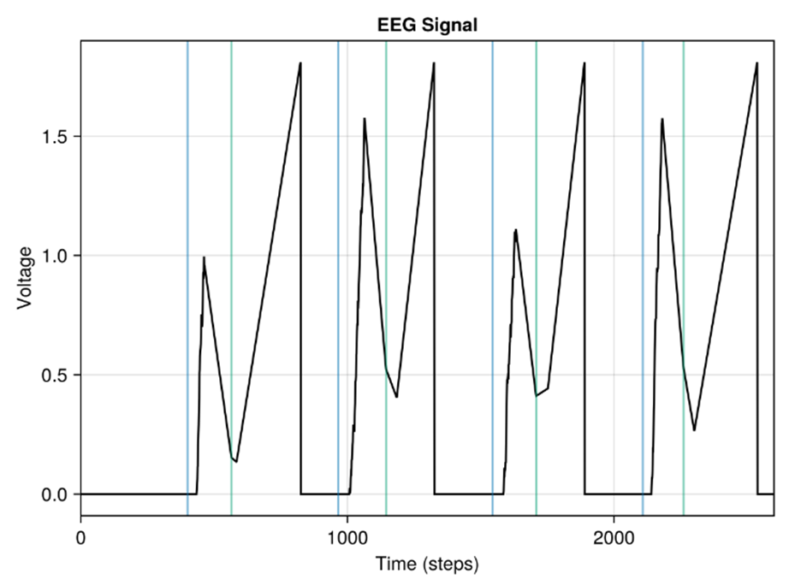
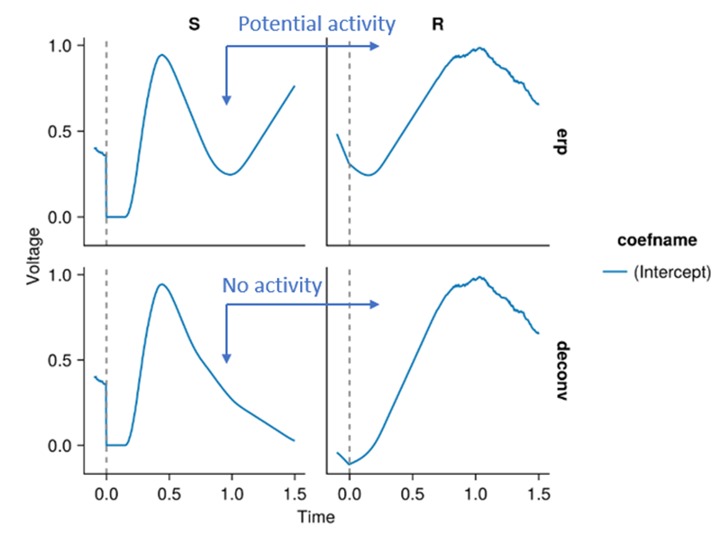
Results – No component activity after deconv
Legend Stimulus(S) Response(R)
own illustration
own illustration

Slide 27


Discussion
Main Contributions:
Extension for decision-making research
Model-Based EEG Simulation
Overlap & Deconvolution Use Cases
Limitations:
Biological parameter validation
Integration of other models
Deconv could be further investigated (RIDE)
Possible Next Steps
Refining EEG simulations & validating with real EEG data
Parameter optimization study & integration of new models

Slide 28
Questions?

Slide 29
Literature
[1]: Redmond G. Connell and Simon P. Kelly. Neurophysiology of human perceptual decision making. Annual Review of Neuroscience, 44(Volume 44, 2021):495–516, 2021.
[2]: Kelly, S. P., Corbett, E. A., & O'Connell, R. G. (2021). Neurocomputational mechanisms of prior informed perceptual decisionmaking in humans. Nature Human Behaviour, 5(4), 467–481. https:// doi.org/10.1038/s41562020009679
[3]: Frömer, R., Nassar, M. R., Ehinger, B. V., & Shenhav, A. (2024). Common neural choice signals can emerge artefactually amid multiple distinct value signals. Nature Human Behaviour, 8(11), 2194 2208. https://doi.org/10.1038/s4156202401971z
[4]: S. D. Brown and A. Heathcote, “The simplest complete model of choice response time: Linear ballistic accumulation,” Cognitive Psychology, vol. 57, no. 3, pp. 153–178, 2008, doi: https://doi.org/ 10.1016/j.cogpsych.2007.12.002.

